Slide 1
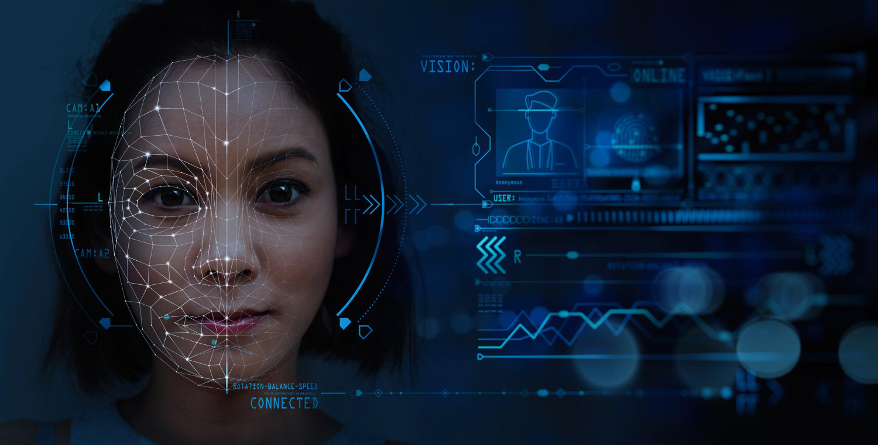
Automatic Class Attendance System Based On Face Detection And Recognition

Slide 2


Introduction :
Traditionally attendance is marked manually by teachers and they must make sure correct attendance is marked for respective student.
This whole process wastes some of lecture time and part of correct information is missed due to fraudulent and proxy cases.

Slide 3
Introduction :
In order to determine classroom attendance, face detection and face recognition are performed. Face detection is used to determine the location of the faces in the classroom image and extract sub images for each face. Then, in face recognition, the face images detected will be compared with the data base consisting of images of students in the class, and attendance will be recorded accordingly.

Slide 4




Significance:
1-Automated
2- Economically
3-Effective
4- Keep extra time

Slide 5
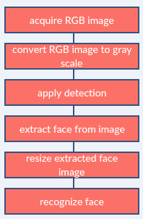
Image processing:

Slide 6
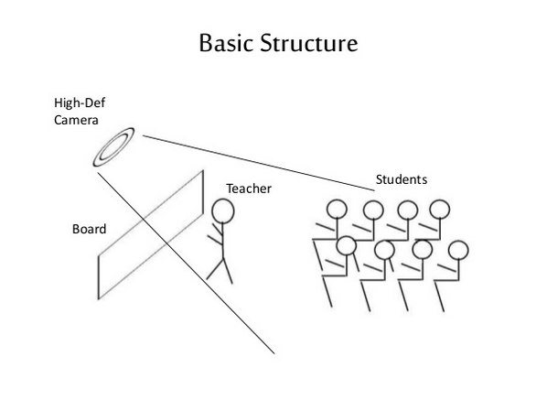

Slide 7
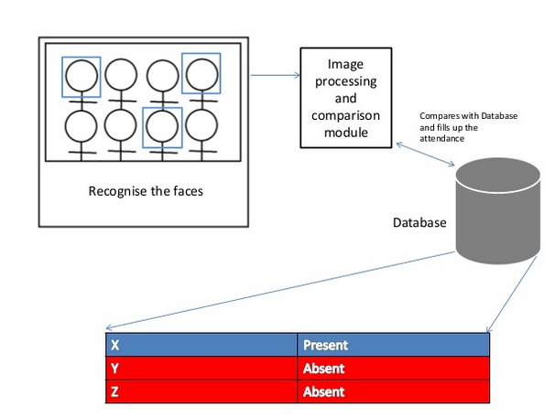

Slide 8
Face Detection:
Face detection is a computer technology used to identify human faces in digital images by determining the location of the faces in the image and extract sub images for each face.

Slide 9
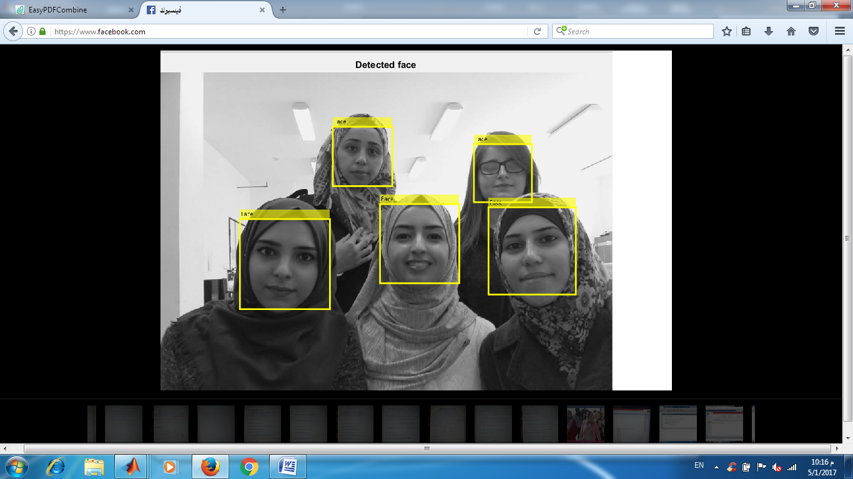
Example for detect face :

Slide 10
How Do We Create Database
Database is the collection of face images and extracted features. And the database includes names of students & registertion number for each student .

Slide 11
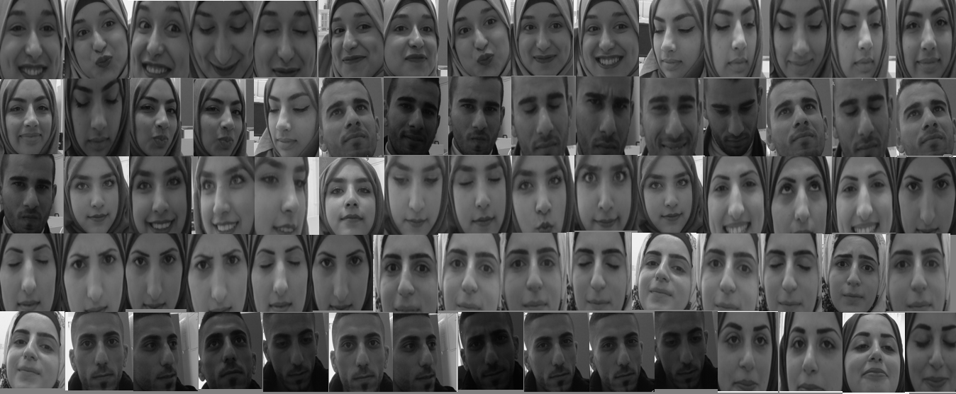
Example for data base images:

Slide 12

Example: database about the information to students :

Slide 13
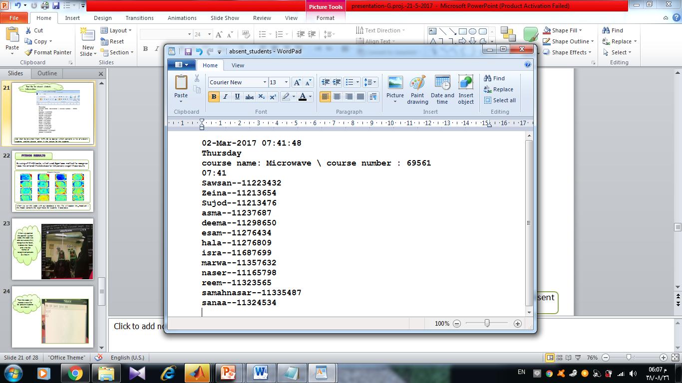
Text file for absent students information:
And then Send email from MATLAB to doctor which contains a list of absent students and the picture taken in the lecture for the students

Slide 14
Future work
Automatic attendance system can be improved by increasing the number of features which can be extracted to increase accuracy of face recognition. Once the software is developed and tested properly, it could be improved to cover full institutions such as the faculty of engineering.

Slide 15


